Slide 1


Only You
Automatic Face Replacement
Web Service for portrait rights protection
using FaceNet and cycleGAN
Team B

Slide 2
“ Contents “
Team Introduction
Project Overview
Development & web UI
Issues
Q&A

Slide 3
“ Contents “
Team Introduction

Slide 4
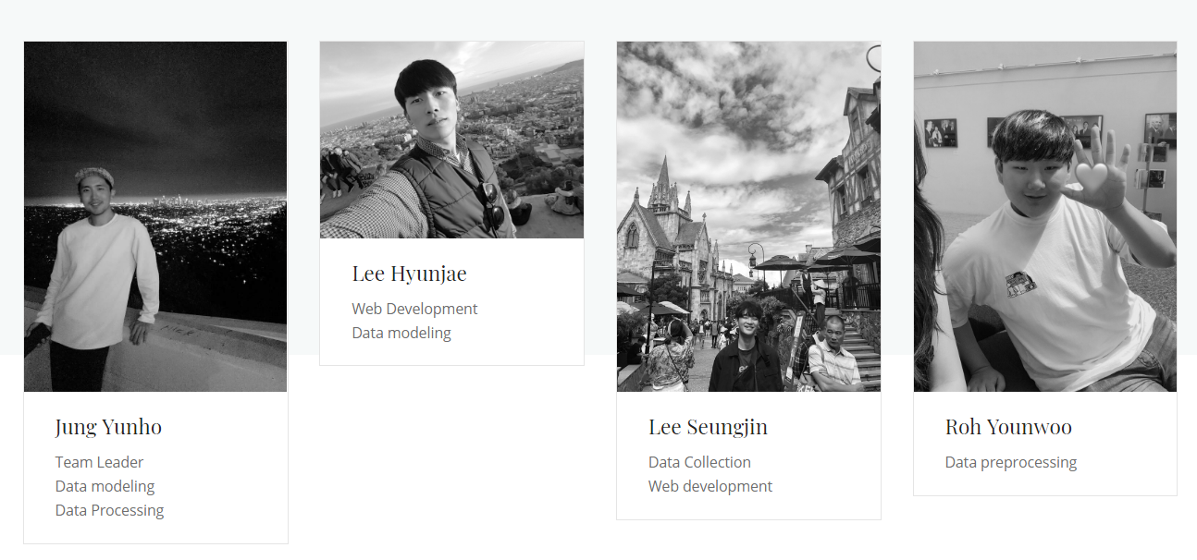
“ Who work for this Project ? “

Slide 5
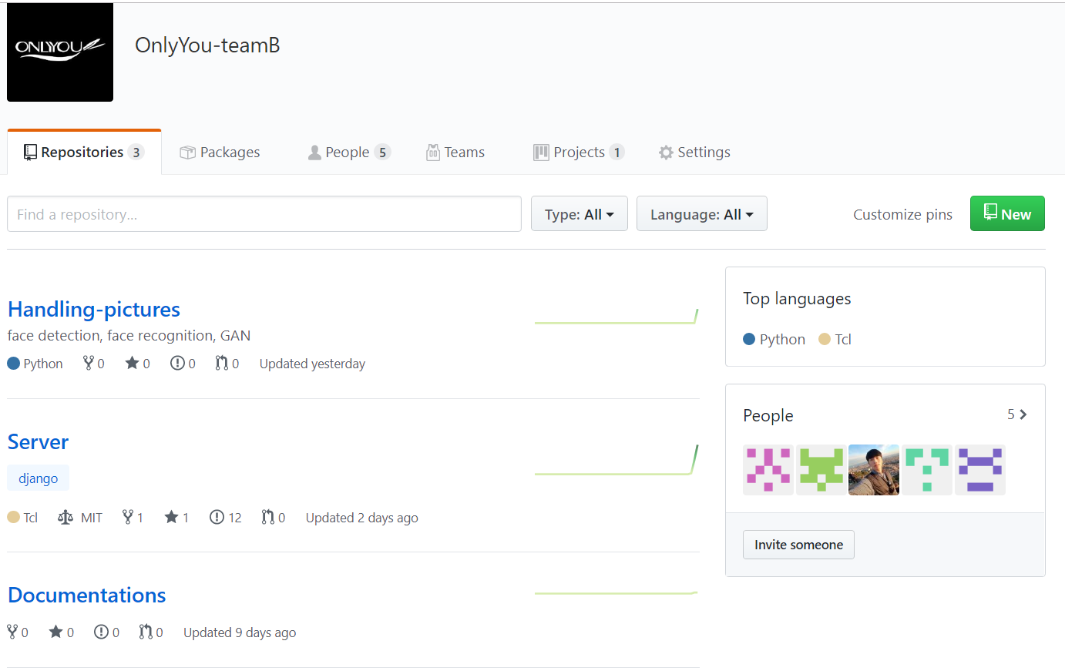
“ How do we collaborate ?“
https://github.com/onlyyou-teamb

Slide 6
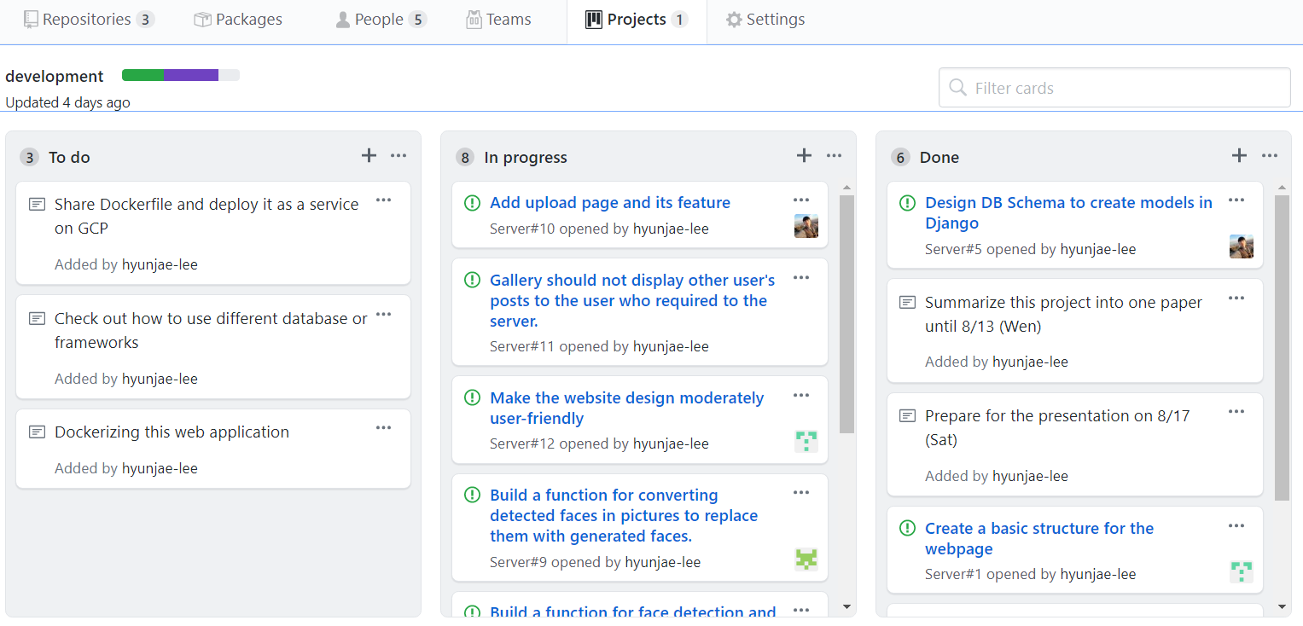
“ How do we collaborate ?“

Slide 7
“ Contents “
2. Project Overview

Slide 8
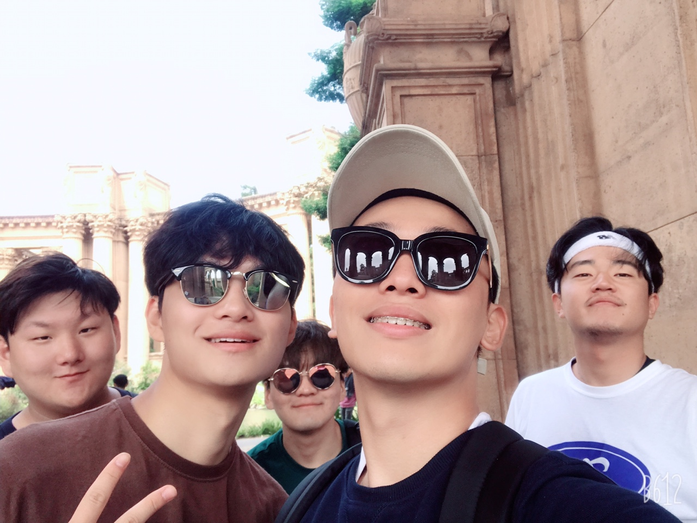

“ Why we start this project ? “
They don’t want to appear..!

Slide 9

“ Why we start this project ? “
If their faces turn into Simpson’s faces..

Slide 10





“ What we use in this project ? “
Face
Recognition
WEB
Machine
Learning
CycleGAN
FaceNet

Slide 11

“ What is Our project plan ? “
1st
Week
2nd
Week
3rd
Week
Web
Web
Modeling & Design
Code Execution
“Brainstorming”
Make user, post model
Design web-page using Bootstrap
Integrity verification
Check Face Recognition code execute correctly
Exception Handling
Preparation for Demo
ML
ML
Modeling
Learning
Write CycleGAN,
Face Recognition code
Start learning with GCP
Preparation for Demo

Slide 12






“ This is What We Want “
Don’t be hesitated
When upload your image
Protecting Everyone’s
Portrait Rights
“If you use our website..”

Slide 13
“ Contents “
3-1. Development

Slide 14


“ Service flow “
Register his photo
User
Look for the user in the picture
Upload a picture
Create another picture that the other’s faces in the picture would be replaced with Simson’s faces

Slide 15
“ How we did this “

Slide 16
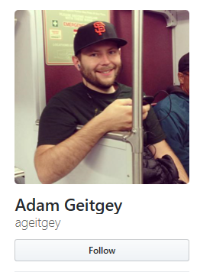
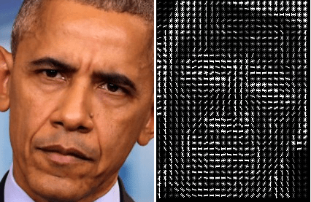
“ Face Recognition “
What Is HOG-Method?

Slide 17
“ How we did this “

Slide 18

“ How we did this “

Slide 19
“ How we did this “

Slide 20
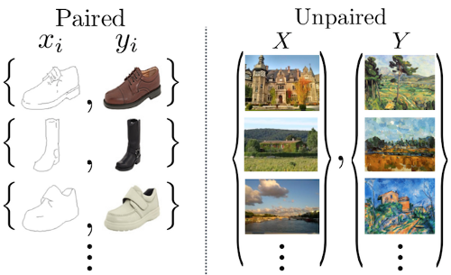
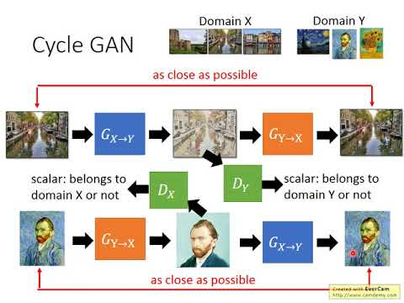
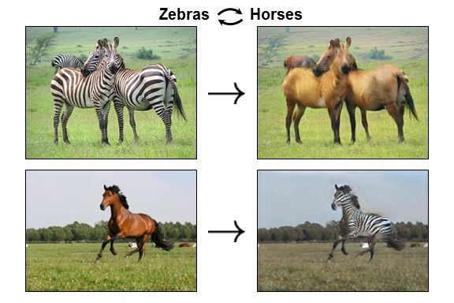
“ What is CycleGAN “
Notes:
# what is cyclegan
now im gonna talking about cycleGAN which is a main model of our service.
cycleGAN is a kind of deep learning model for img to img translation with a specific style domain.
# 2nd animation
this is a simple flowchart about how CycleGAN trains.
There are two special issues to note about cycleGAN
# 3nd unparied dataset
first, unlike pix2pix model, cyclegan use unpaired data for learning. So it can train a model much easier. because there is few paired data in real world.

Slide 21
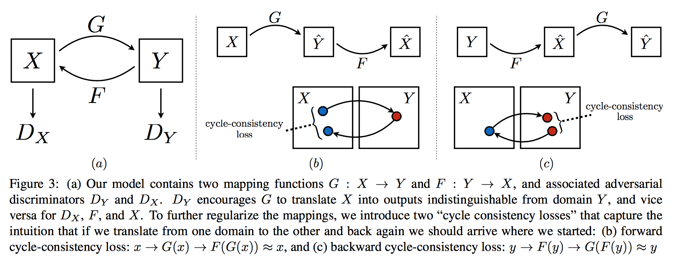
“ What is CycleGAN “
Notes:
# 4nd animation
secondly, cycleGAN adds cycle-consistency loss to its loss function.
The purpose of cycleGAN is to learn a mapping function beweent domain X and domain Y, in our case, domain X is sth human-style domain and domain Y is sth simpson-style domain.
as cyclegan is a also generative adversarial networks, its loss function contains adversarial loss. but there are too many x to y mapping function, that is generatorXtoY, so it cannot assure that the result of img translation with domainB and going back to original domain is same with original one.
But input x should be same as the result of GeneratorYtoX of the previous result of GeneratorXtoY of inputx, like a cycle.
so cycleGAN adds cycle-consistenct loss to its loss function.

Slide 22
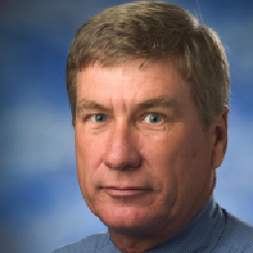

“ Dataset “
Human Face
Simpson Face
https://github.com/NVlabs/ffhq-dataset
https://www.kaggle.com/kostastokis/simpsons-faces
Notes:
# dataset
as i have already talked about dataset, human face is train data for domain X and simpson face is train data for domain Y.

Slide 23
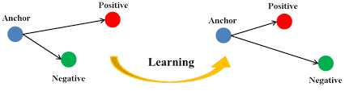
“ How can we develop “
Face Net : search face with KNN Method
Notes:
# facenet
previously, we used face_recognition which is opensource api for human face recognition for seaching the face which user registered for default img before.
but it take pretty long time to search the face, maybe 30second i think, so we are on our way to applying facenet with a knn algorithm for real-time operation.

Slide 24
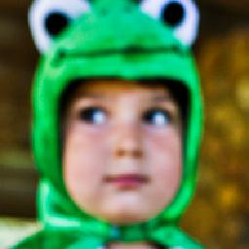

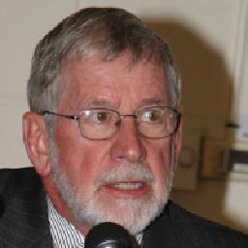
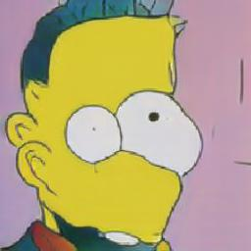
“CycleGAN images from train data set “
Notes:
# facenet
previously, we used face_recognition which is opensource api for human face recognition for seaching the face which user registered for default img before.
but it take pretty long time to search the face, maybe 30second i think, so we are on our way to applying facenet with a knn algorithm for real-time operation.

Slide 25
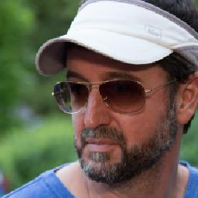
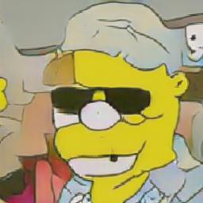
“ CycleGAN images from train data set “
Notes:
# facenet
previously, we used face_recognition which is opensource api for human face recognition for seaching the face which user registered for default img before.
but it take pretty long time to search the face, maybe 30second i think, so we are on our way to applying facenet with a knn algorithm for real-time operation.

Slide 26
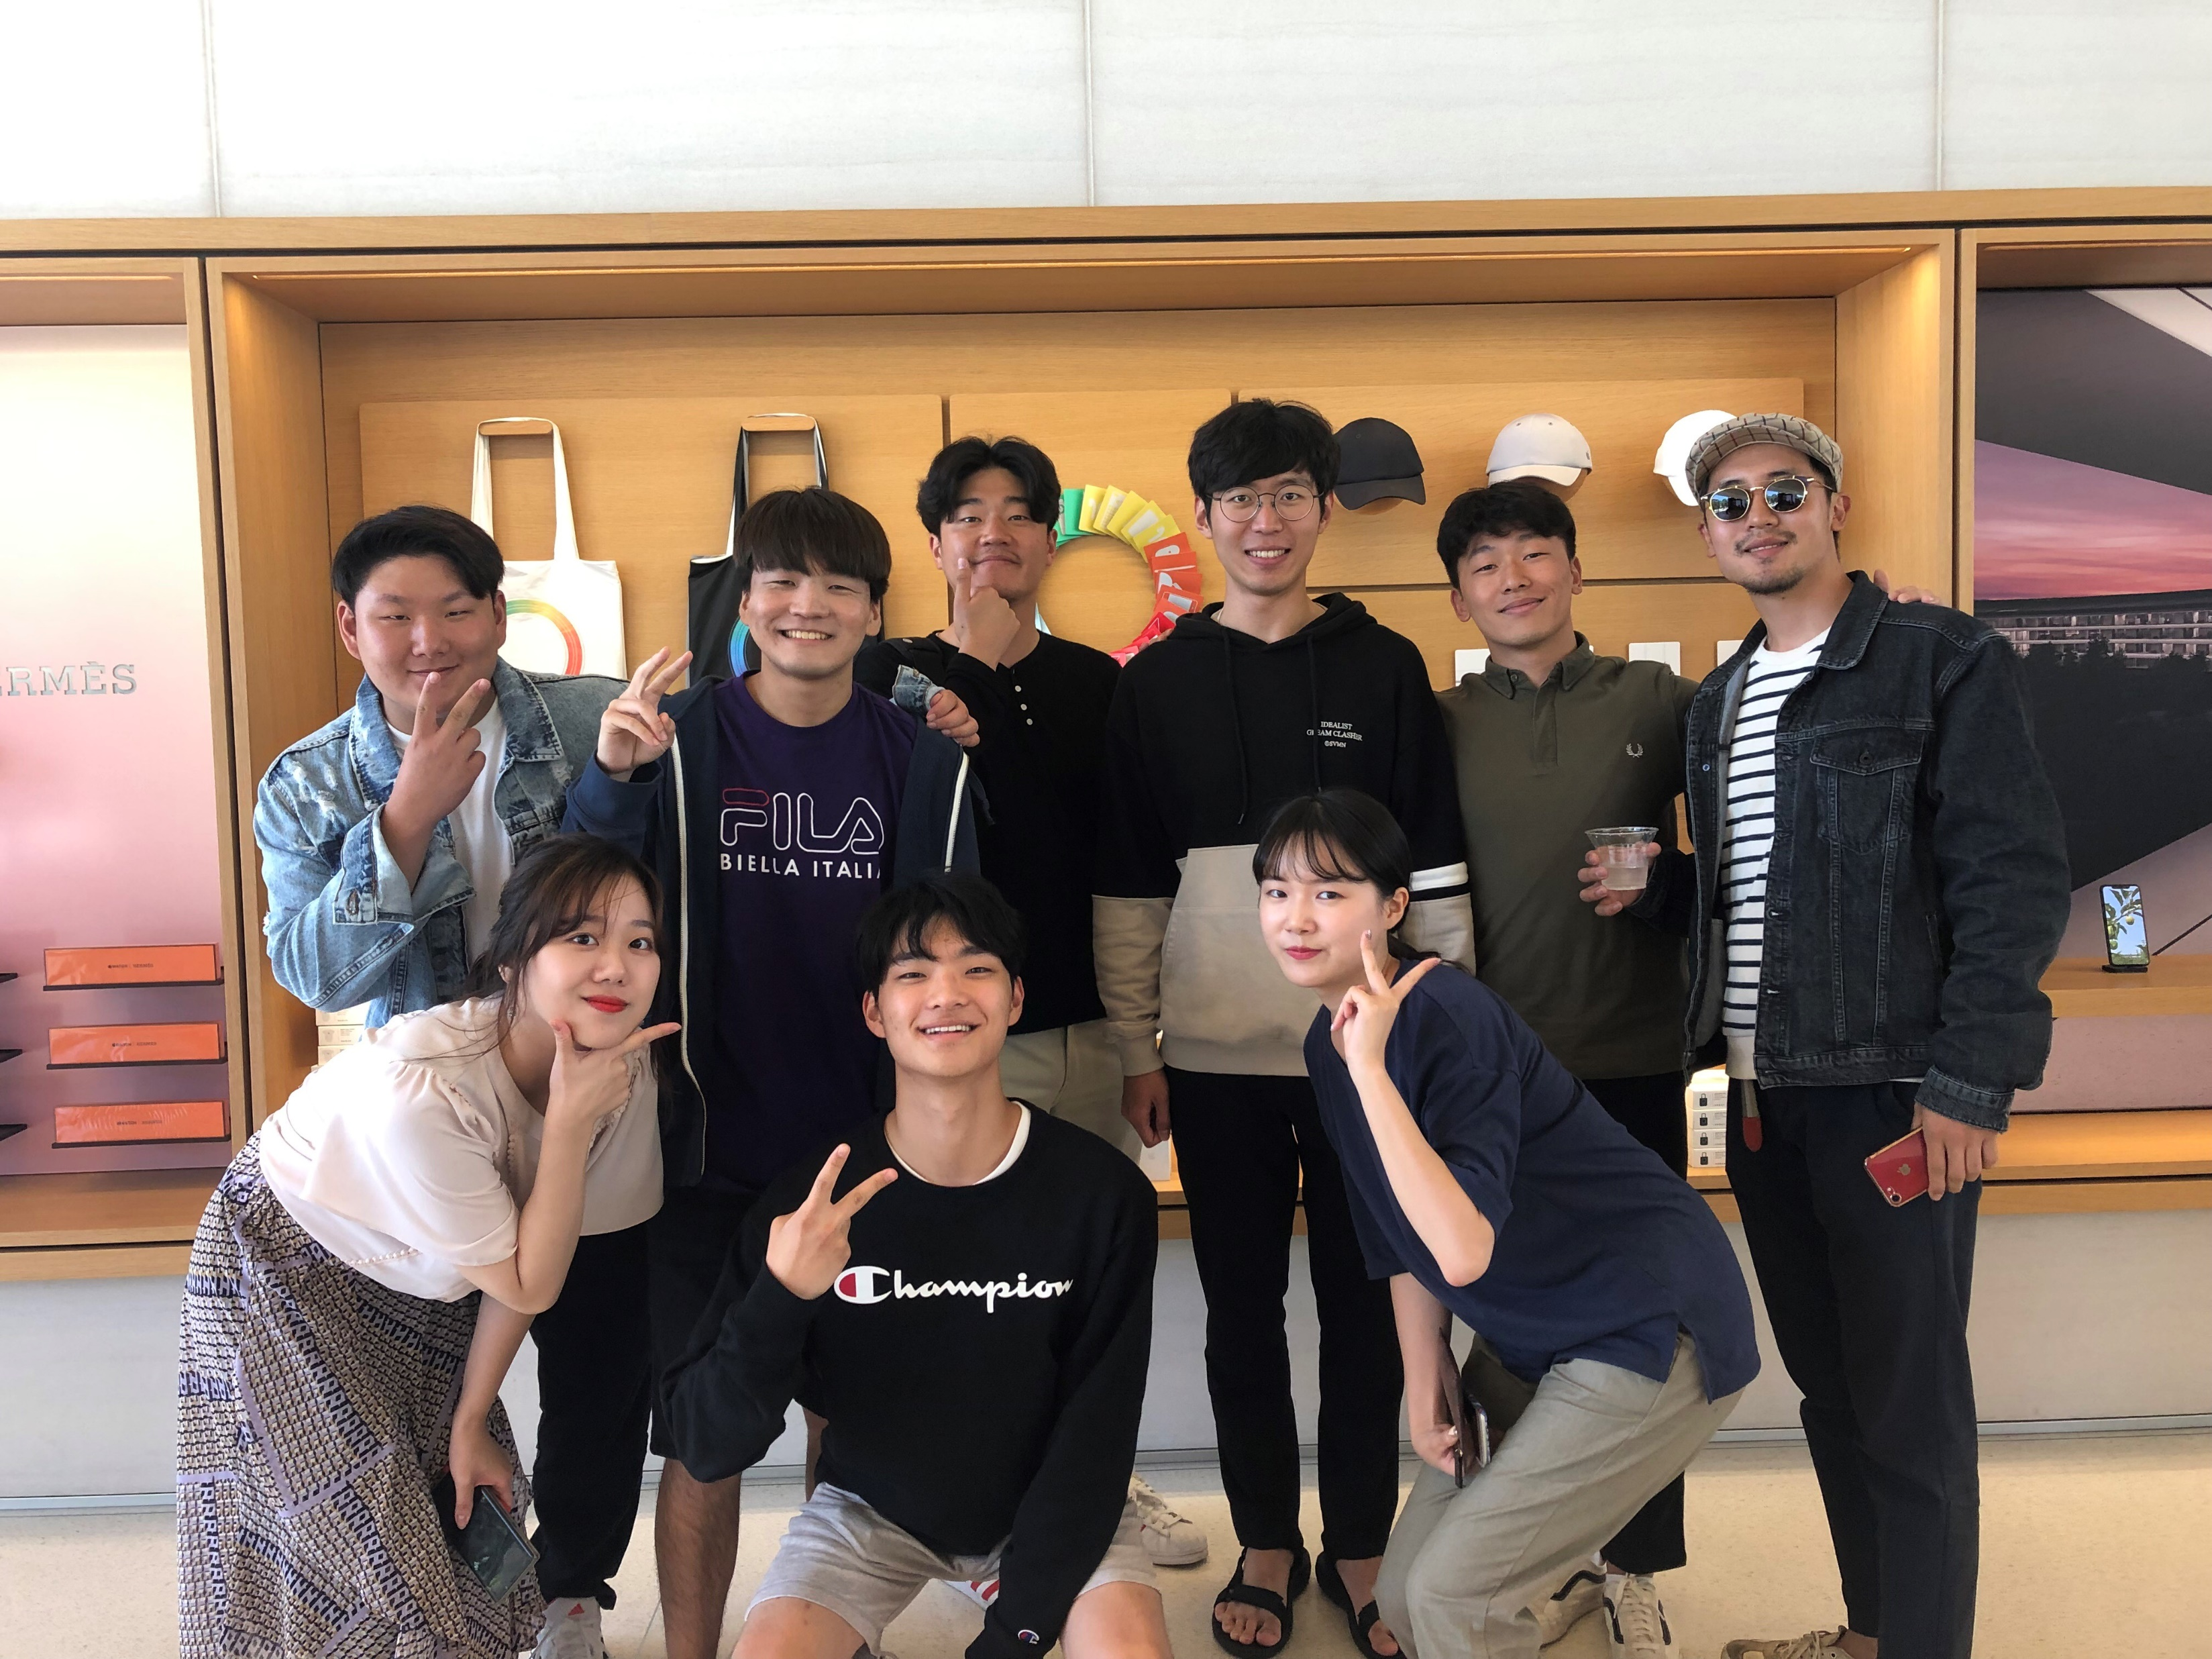
“ Results “
Notes:
# facenet
previously, we used face_recognition which is opensource api for human face recognition for seaching the face which user registered for default img before.
but it take pretty long time to search the face, maybe 30second i think, so we are on our way to applying facenet with a knn algorithm for real-time operation.

Slide 27
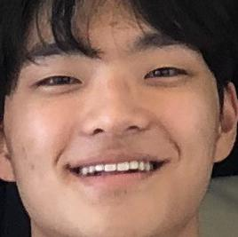
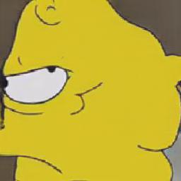
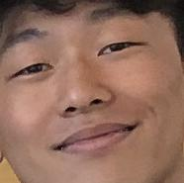

“ Results “
Notes:
# facenet
previously, we used face_recognition which is opensource api for human face recognition for seaching the face which user registered for default img before.
but it take pretty long time to search the face, maybe 30second i think, so we are on our way to applying facenet with a knn algorithm for real-time operation.

Slide 28
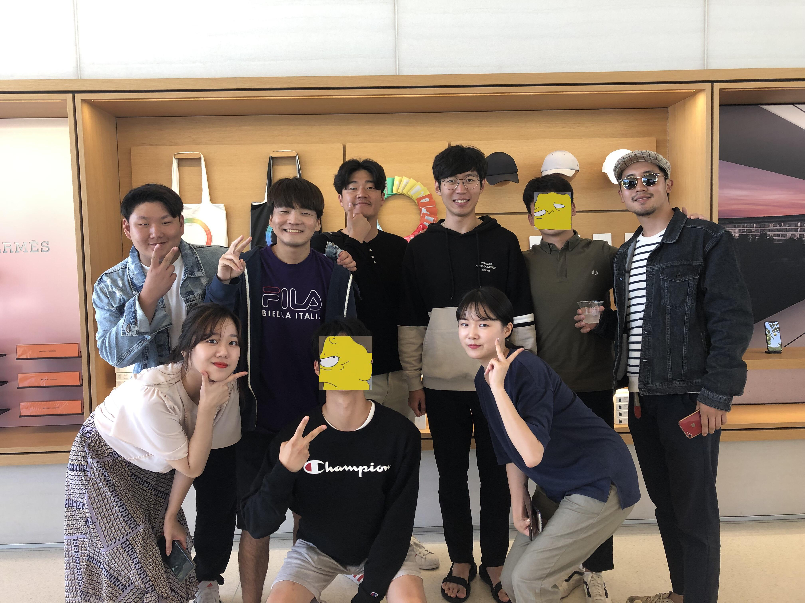
“ Results “
Notes:
# facenet
previously, we used face_recognition which is opensource api for human face recognition for seaching the face which user registered for default img before.
but it take pretty long time to search the face, maybe 30second i think, so we are on our way to applying facenet with a knn algorithm for real-time operation.

Slide 29
“ Contents “
3-2. Web UI
Notes:
# issue
now Im gonna talking about issues.
1. we are django newbies. so i had hard time in developing backend system.
2.

Slide 30
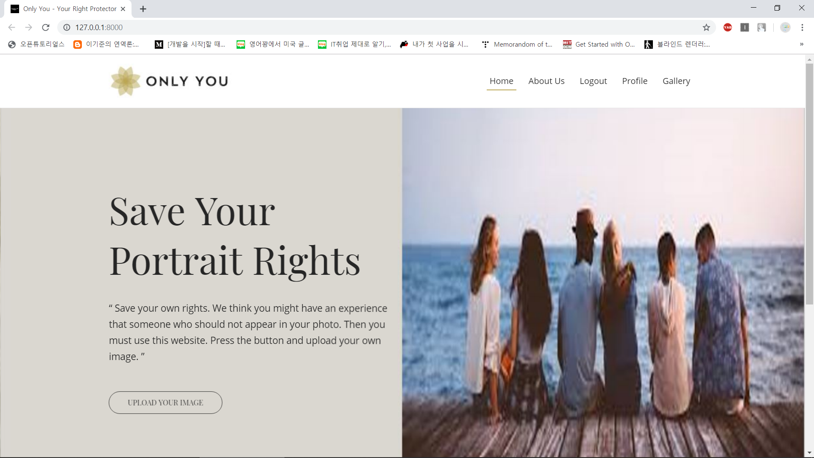
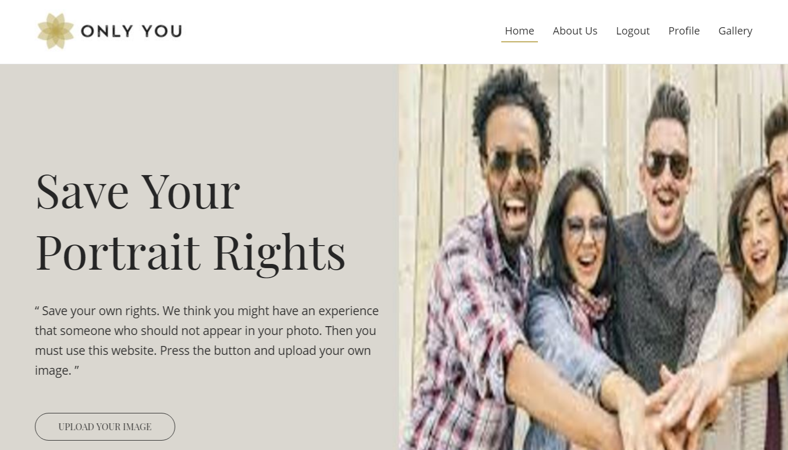
“ Web UI “
Notes:
# facenet
previously, we used face_recognition which is opensource api for human face recognition for seaching the face which user registered for default img before.
but it take pretty long time to search the face, maybe 30second i think, so we are on our way to applying facenet with a knn algorithm for real-time operation.

Slide 31
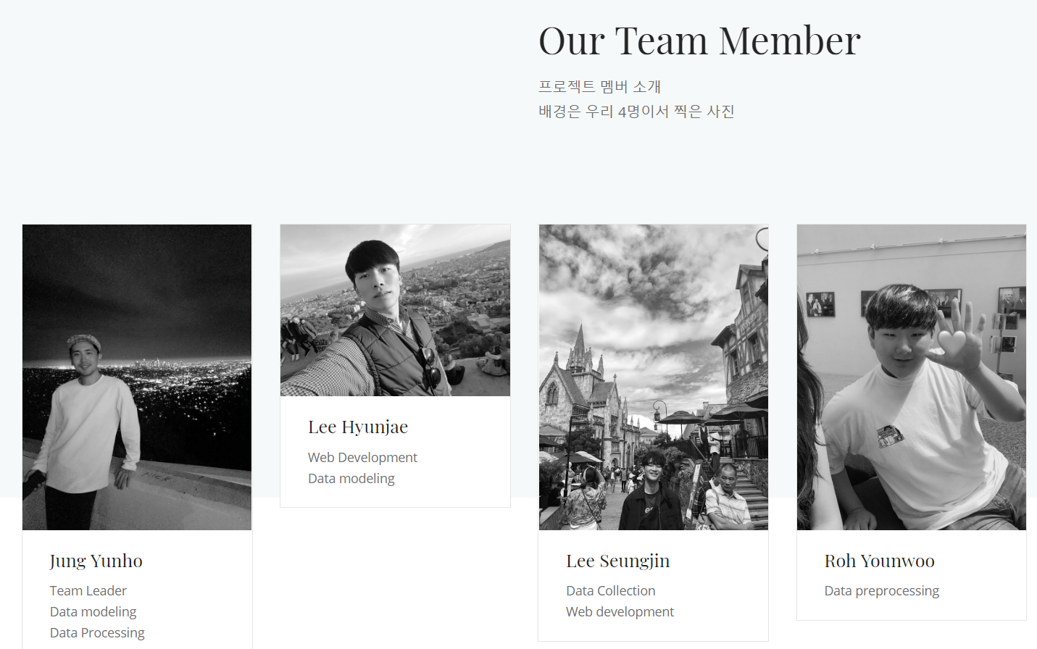
“ Web UI “
Notes:
# facenet
previously, we used face_recognition which is opensource api for human face recognition for seaching the face which user registered for default img before.
but it take pretty long time to search the face, maybe 30second i think, so we are on our way to applying facenet with a knn algorithm for real-time operation.

Slide 32
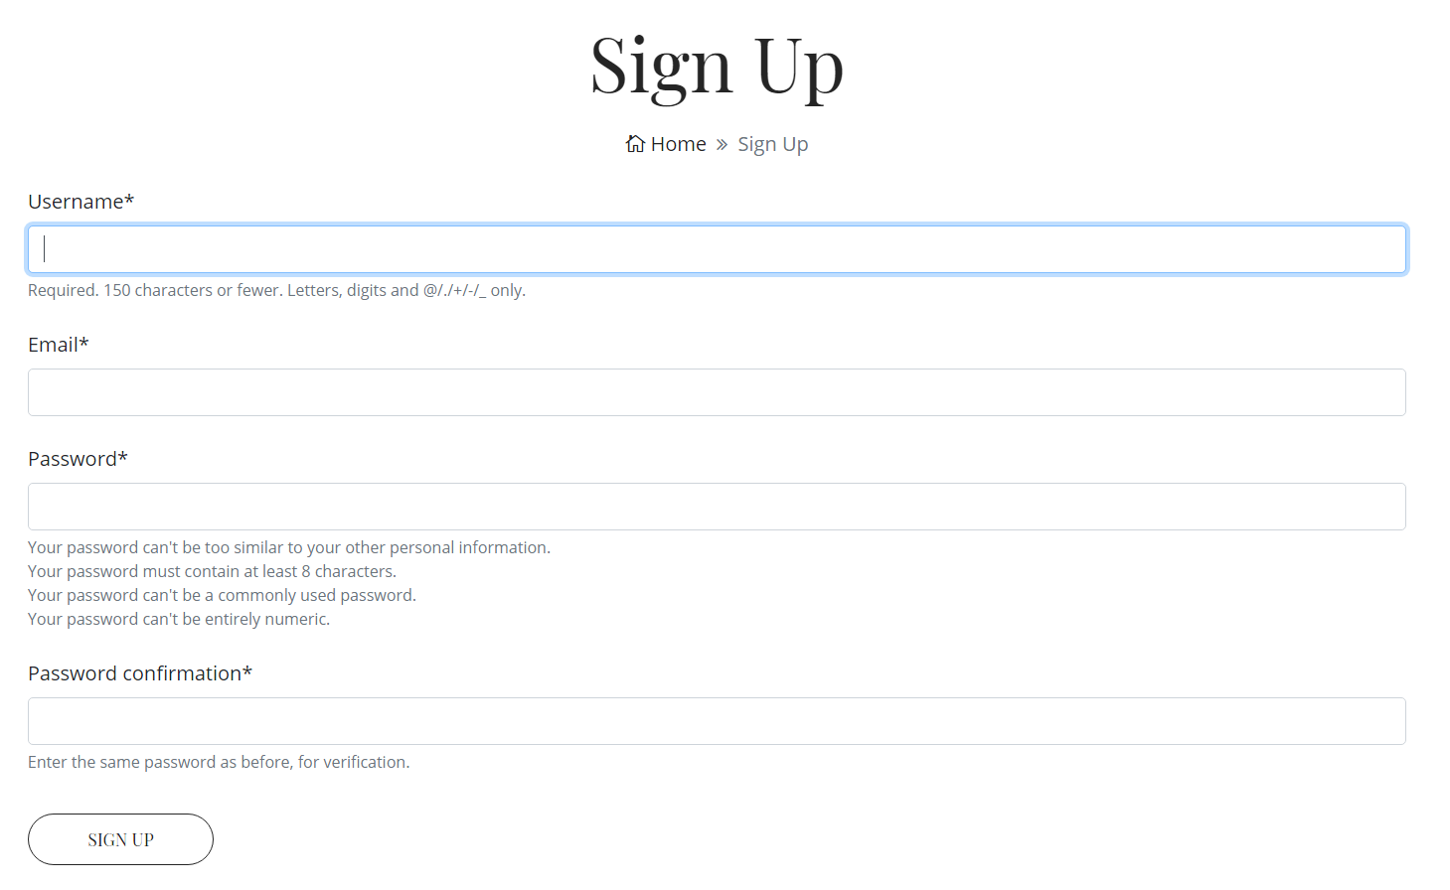
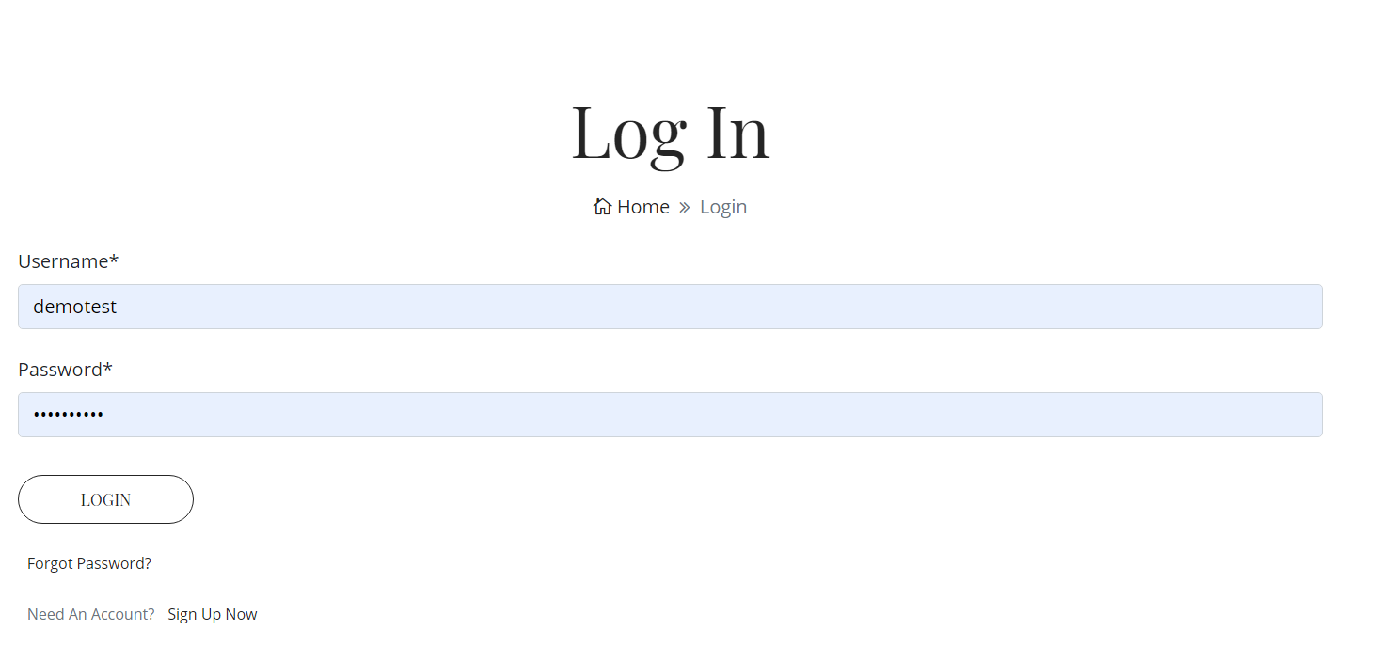
“ Web UI “
Notes:
# facenet
previously, we used face_recognition which is opensource api for human face recognition for seaching the face which user registered for default img before.
but it take pretty long time to search the face, maybe 30second i think, so we are on our way to applying facenet with a knn algorithm for real-time operation.

Slide 33

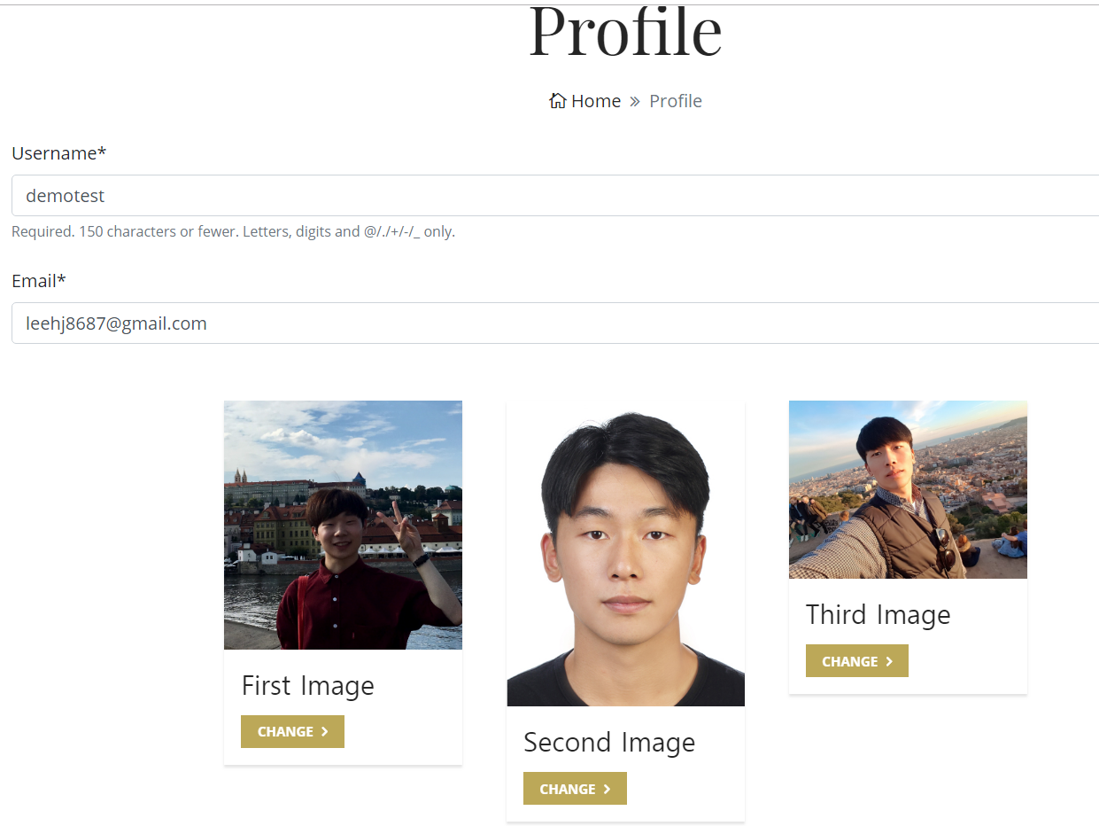
“ Web UI “
Notes:
# facenet
previously, we used face_recognition which is opensource api for human face recognition for seaching the face which user registered for default img before.
but it take pretty long time to search the face, maybe 30second i think, so we are on our way to applying facenet with a knn algorithm for real-time operation.

Slide 34
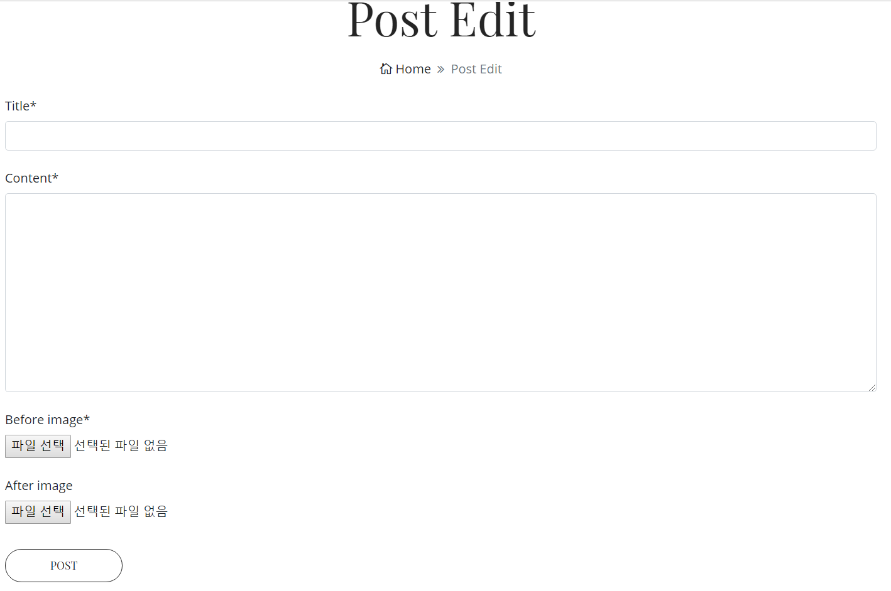
“ Web UI “
Notes:
# facenet
previously, we used face_recognition which is opensource api for human face recognition for seaching the face which user registered for default img before.
but it take pretty long time to search the face, maybe 30second i think, so we are on our way to applying facenet with a knn algorithm for real-time operation.

Slide 35
“ Contents “
4. Issues
Notes:
# issue
now Im gonna talking about issues.
1. we are django newbies. so i had hard time in developing backend system.
2.

Slide 36
“ These are Our Issues ! “
We are Django newbies!
How can we deploy our app with Docker ?
Lack of resources and time for training data
Real-time operation problems

Slide 37
“ Limits…. “
It took so long for training the model(over 5days)
So, we had problems in tuning HyperParameter after training
We wanted to make the surrounding of faces look more natural
The face data of training sets mostly included western faces
So, it couldn’t recognize eastern faces’ features

Slide 38
Q & A
Notes:
# Q & A
presentation is done, and is there any question or feedback?
finish our presentation
thank you

Slide 39
“ Reference “
https://github.com/davidsandberg/facenet
https://github.com/xhujoy/CycleGAN-tensorflow
https://www.kaggle.com/kostastokis/simpsons-faces
https://github.com/NVlabs/ffhq-dataset
https://www.cvfoundation.org/openaccess/content_cvpr_2015/papers/Schroff_FaceNet_A_Unified_2015_CVPR_paper.pdf
https://www.youtube.com/watch?v=9N_uOIPghuo

